Slide 1


Hands-on for Gen-AI
Date of Submission: 06 May 2024

Slide 2
Title
Team Name: Code Ninjas
Hackers:
Rajender Siriseti, Mangesh Chandgadkar and Sharmila Devi Chandariah
Use case description (O-2) :
Engineering firms handle extensive volumes of engineering documentation, including manuals, reports, and technical specifications. However, without efficient document search capabilities, valuable knowledge contained within these documents often goes underutilized. Moreover, employee turnover can result in the loss of institutional knowledge, further complicating the retrieval of relevant information. Generative AI offers a solution to this problem by enhancing document search and knowledge retrieval processes. By analyzing the content of documents, training manuals, and other resources, generative AI can generate more accurate and context-aware search results, enabling employees to access relevant information quickly and efficiently.

Slide 3
Problem Statement
Organizations are inundated with extensive volumes of documentation, including manuals, reports, and technical specifications, leading to challenges in efficient document management.
Inefficient document search capabilities result in underutilization of valuable knowledge, while employee turnover exacerbates the issue by causing the loss of institutional knowledge.
The proliferation of duplicate documents consumes valuable storage space and complicates document organization, hindering effective information retrieval.
The absence of a streamlined process for organizing relevant documents further compounds the problem, making it difficult for employees to access the information they need in a timely manner.

Slide 4
Target Users
Enterprise Organizations:
Enable employees within enterprise organizations to perform efficient searches and queries, enhancing productivity and knowledge retrieval.
Streamline storage efficiencies by eliminating duplicate documents and organizing relevant documents, optimizing storage resources.
Individuals Seeking Document Organization:
Assist individuals in organizing their folders and documents across a variety of formats, including PDFs, texts, Word documents, and Excel spreadsheets.
Provide a seamless experience for individuals to manage their personal and professional documents efficiently.
Integration with Existing Storage Management Solutions:
Extend support for integration with existing storage management solutions such as Box, SharePoint, and others.
Enhance the capabilities of these platforms by providing advanced document search, organization, and storage optimization features.

Slide 5
Our Solution & Key Technical Components
Our solution harnesses the power of the RAG (Retrieval-Augmented Generation) architecture, Langchain, and Azure Open AI services to transform engineering documentation management.
Content Analysis with Azure AI Embeddings:
Azure AI Embeddings analyze document content to extract key concepts, terms, and topics, providing a deeper understanding of the information. This component enhances the solution's capability to interpret and categorize documents, facilitating efficient knowledge retrieval and topic modeling.
Context-Aware Search Powered by Azure AI Search:
Azure AI Search algorithms provide context-aware search results, tailored to the specific needs and preferences of users, improving relevance. By integrating Azure AI Search, the solution ensures that search queries yield highly relevant results, enhancing user satisfaction and productivity.
Interactive Chatbot with Langchain QAretrieval:
Powered by the RAG architecture, Langchain QAretrieval facilitates an interactive chatbot interface, enabling users to engage directly with documents, thereby enhancing accessibility and usability. RAG typically utilizes vector indexes to search for relevant content within unstructured data.
Cosine Similarity Function for Document Similarity Index:
Implemented a document similarity index using Azure AI, efficiently organizing documents, eliminating duplicates, and grouping related documents for streamlined access. This component optimizes storage efficiency and organization, reducing redundancy and simplifying document management tasks for users.
Topic Modeling with LDA:
LDA (Latent Dirichlet Allocation) is employed for topic modeling, uncovering latent topics within the document corpus. By applying LDA, the solution identifies underlying themes and topics across documents, enabling users to explore and understand the content in a structured manner.

Slide 6
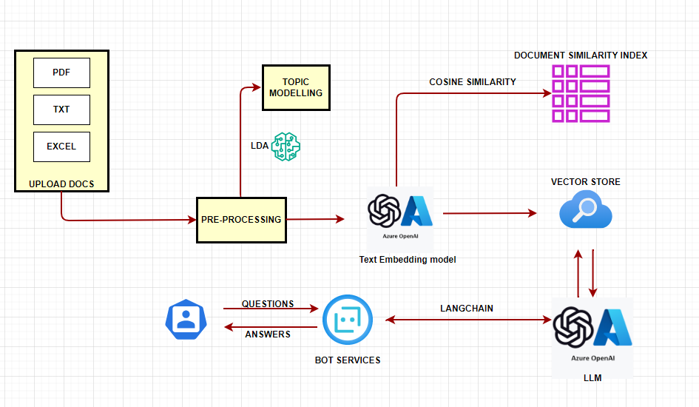
Solution Design

Slide 7
Relevant Metrics
Evaluating the quality of chatbot responses is still evolving. A few considerations to evaluate these bot responses include accuracy through examples and using LLM as a judge.
Considered best practice to use low temperature to ensure reproducibility.
AI search client results can be evaluated utilizing 'search.score.'
Costs are categorized by search services (high cost), Azure AI services, and storage. A few recommendations to leverage ensemble of indexes for better utilization are also suggested.

Slide 8
Conclusion
Our solution presents a comprehensive approach to tackle the challenges associated with managing extensive volumes of unstructured documents. By offering features like streamlined retrieval, enhanced organization through labeling and index search, and the incorporation of document similarity indexes, our solution significantly improves efficiency in document management.
Our platform is designed for further optimization
Experimenting with multiple index ensembles,
Ensuring data reproducibility through DB solution integration,
Implementing caching techniques to increase bot response speed and
Extend cosine similarities to build knowledge graph for each document
Leveraging DevOps tools for deployments
With these capabilities, our solution not only addresses current document management issues but also provides a scalable and adaptable framework for future enhancements, empowering organizations to efficiently manage their vast repositories of engineering documentation.

Slide 9
Appendix

Slide 10
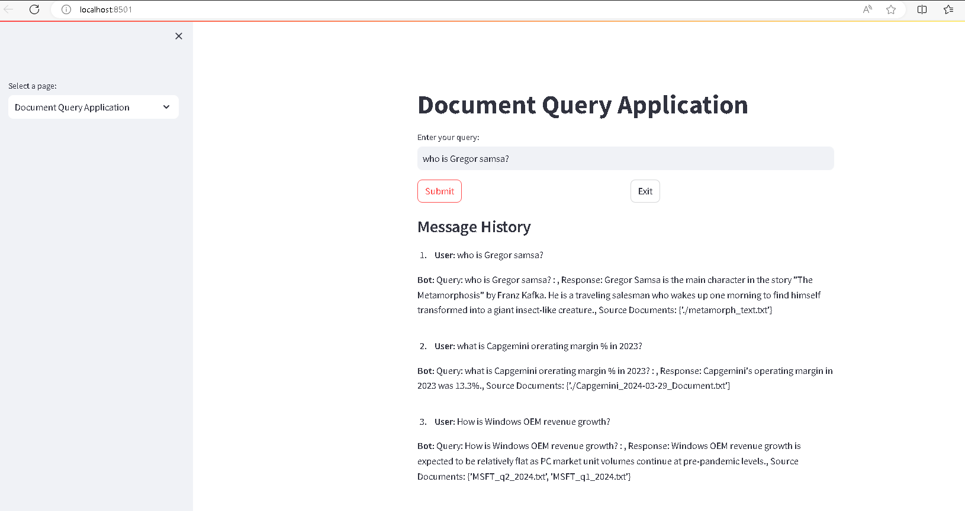
Solution – UI Screens

Slide 11
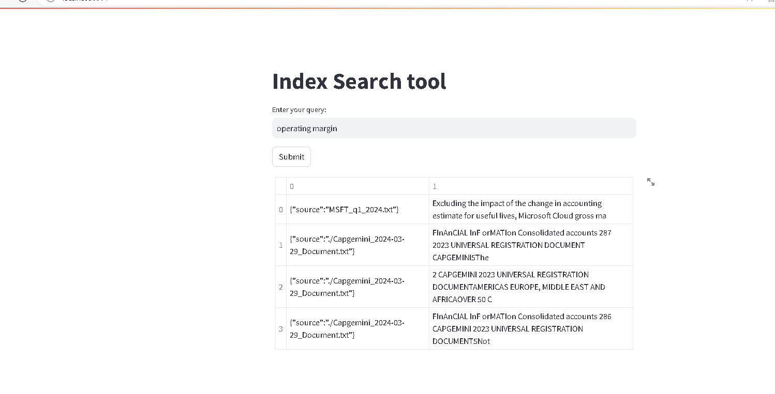
Solution – UI Screens

Slide 12
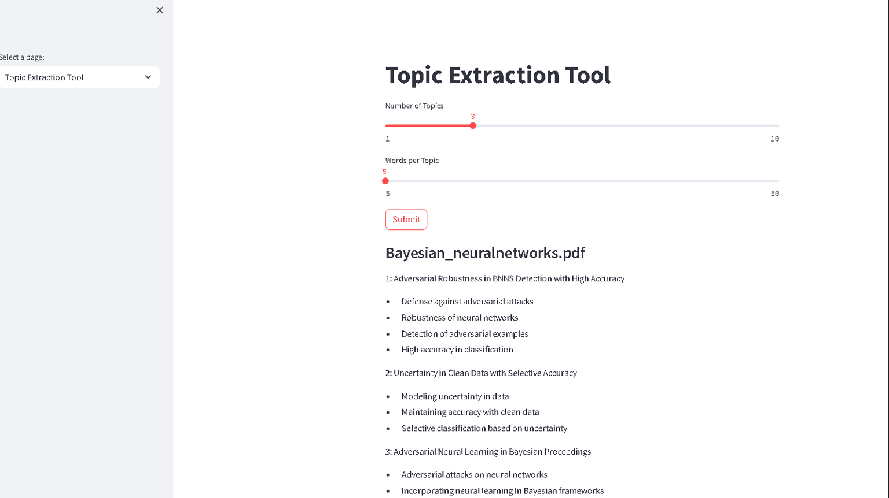
Solution- UI Screens

Slide 13
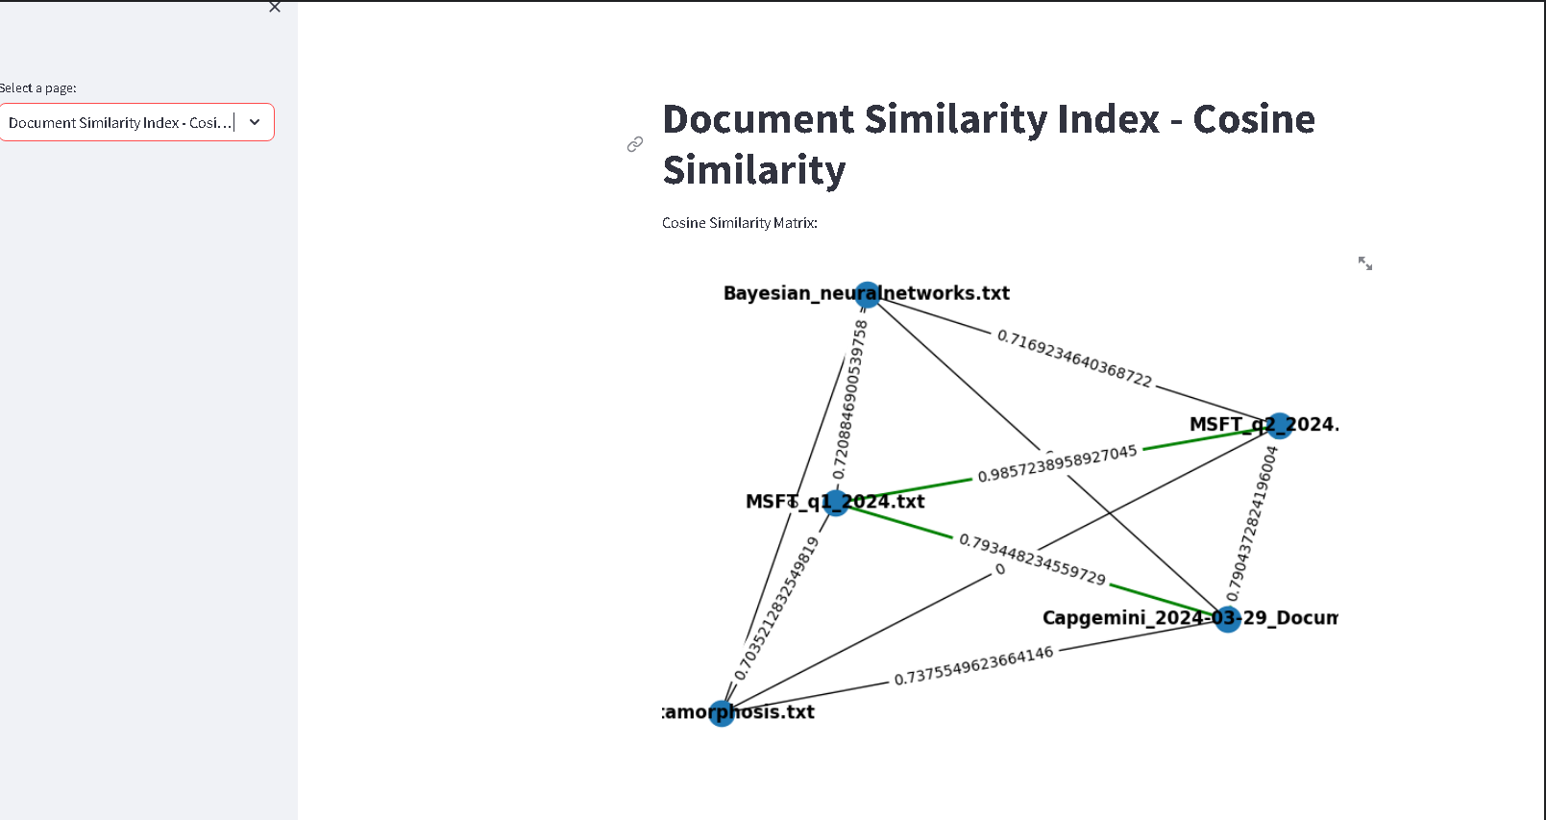
Solution UI Screens

